Slide 1

Three modes/models
Command
To generate new code or edit existing code via natural language inputs, directly in the editor window
Chat
To talk to your codebase from within your editor
Autocomplete
To make in-line and multi-line suggestions based on the context of your code
Generated with Imagen3 by Google DeepMind
Notes:
Codeium accelerates software development through three key modes: Command, Chat, and Autocomplete. Each mode leverages Codeium’s real-time context awareness engine to deliver highly relevant and useful suggestions.

Slide 2
Three modes/models
Generate new code
Optimize/refactor existing code
Identify/fix bugs
Generated with Imagen3 by Google DeepMind
Notes:
Code optimization is the process of making your code faster (reducing runtime), more efficient (using fewer resources like memory and disk), and/or more readable (easier for developers to maintain). Some common strategies for code optimization include:
- **Algorithmic optimization**: Improving the efficiency of algorithms to reduce the time or space complexity. *Example*: Reducing time complexity from O(n²) to O(n log n) by choosing the right sorting algorithm.
- **Code refactoring**: Eliminate redundancy, improve readability, and enhance maintainability without changing the code's functionality. *Example*: Replace nested loops with more concise operations like `map`, `filter`, or comprehensions.
- **Memory optimization**: Reducing memory usage by optimizing data structures, avoiding memory leaks, and minimizing unnecessary allocations. *Example*: Using generators instead of lists to avoid storing all elements in memory.
- **Parallelism and concurrency**: Utilize parallel processing or multithreading to split tasks. *Example*: Process chunks of data simultaneously using `multiprocessing` in Python.
Much more can be said about code optimization, but these are some common strategies to keep in mind as you work with Codeium.

Slide 3
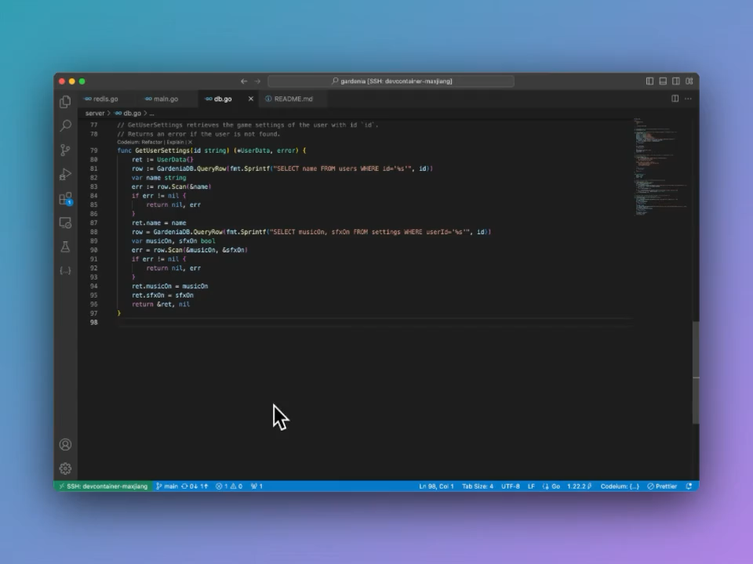
Command
Enter a Prompt
MacOS: ⌘+I
Win/Linux: ctrl+I
Accept suggestion
MacOS: ⌥+A
Win/Linux: Alt+A
Reject suggestion
MacOS: ⌥+F
Win/Linux: Alt+F
Notes:
Sometimes it can be easier to describe the what we want to code in natural language, especially when writing simple pieces of code. In this episode, we will learn to use the Command feature of Codeium, which allows you to generate or modify code simply by using natural language inputs. Instead of manually coding everything, you can describe what you want in plain English, and Codeium will help you do it — whether it’s creating new functions or refactoring existing pieces of code.
By pressing command+I on Mac or Ctrl+I on Windows/Linux, you can enter a prompt and receive code suggestions, making it easier and faster to develop code directly within your editor.
Codeium will then provide a multiline suggestion that you can accept or reject. You can accept a suggestion by pressing Option+A on Mac or Alt+A on Windows/Linux, reject (Option+R on mac or Alt+R on Windows/Linux), or follow-up a generation (Option+F on Mac or Alt+F on Windows/Linux) by using the appropriate shortcuts or by clicking the corresponding code lens above the generated diff.
If you highlight a section of code before invoking Command, then the AI will edit the selection spanned by the highlighted lines. Otherwise, it will generate code at your cursor’s location.

Slide 4
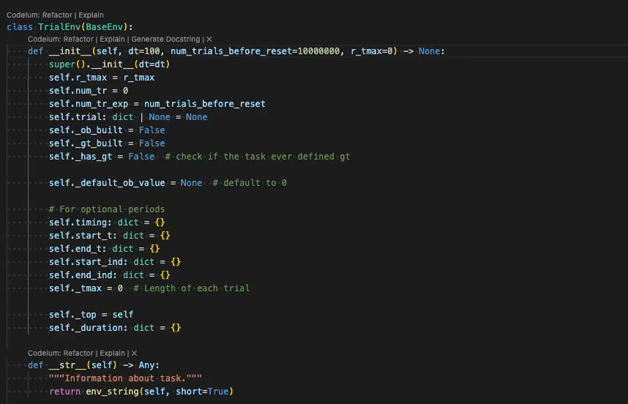
Command – Refactoring&Docstrings
Code lenses
Refactor functionality
Docstring Generation
Notes:
In Codeium, code lenses appear right above your function and class definitions, providing convenient shortcuts for common tasks. These clickable labels allow you to quickly generate docstrings, explain code, or refactor code with just a click, saving time on manual edits. These features are powered by Command, which uses natural language inputs to assist with tasks like improving code structure and generating documentation.
Codeium’s Command feature enhances your coding workflow by offering specific functions through code lenses.
Refactor Functionality: Clicking the Refactor label triggers Codeium’s refactoring capabilities, providing a dropdown of pre-filled options or allowing you to write a custom instruction. This is particularly useful for improving performance or restructuring code. You can also highlight a block of code and use Command (command+I or Ctrl+I) to perform more targeted refactoring.
Docstring Generation: For generating documentation, clicking the Docstring label automatically creates a docstring above your function header (or under the function header in Python). This AI-generated documentation will describe what the function does, helping you maintain well-documented, readable code.

Slide 5

Command – Best practices
Advanced model behind Command
Highlight a specific piece of code before using Command
Give clear and detailed prompts
E.g., Write a function that takes two inputs of type Diffable and implements the Myers diff algorithm
Always review AI-generated code
Icon taken from https://www.flaticon.com/
Notes:
Here are a few things to remember when using Command function of Codeium:
The model behind Command is more advanced than the one used for autocomplete, making it slower but more capable of following complex instructions.
To edit a specific selection of code, highlight that piece of code before using Command. If not, it will generate new code at the cursor’s position.
For effective use, try to give clear and detailed prompts. While simple requests like “Fix this” or “Refactor” can work well due to context awareness, more specific instructions like “Write a function that takes two inputs of type Diffable and implements the Myers diff algorithm” can yield even better results.
Always review AI-generated code to ensure they accurately reflect the purpose and parameters of the function.

Slide 6
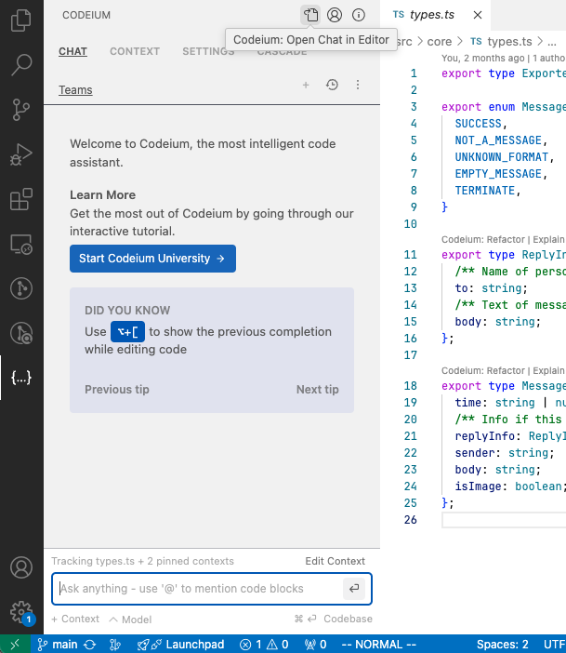
Chat
Similar to the Command function
Chat with the AI assistant
Get instant feedback
Interact
By default on the left sidebar
Open the chat panel
MacOS: ⌘+⇧+A
Win/Linux: ctrl+⇧+A
Notes:
The Codeium Chat feature offers a powerful way to interact with an AI assistant directly within your coding environment, providing instant, contextual feedback on your code. Unlike the Command function, Codeium Chat is designed for a more conversational and responsive interaction, making it easy to discuss complex coding questions and solutions.
In Visual Studio Code, you can access Codeium Chat by clicking on the Codeium icon located in the left sidebar by default.
To quickly open the chat panel or toggle focus between it and your code editor, use command+shift+A on Mac or Ctrl+shift+A on Windows/Linux. For a more flexible experience, you can pop the chat panel out of the IDE entirely by clicking the “pop-out” icon at the top of the chat window.

Slide 7
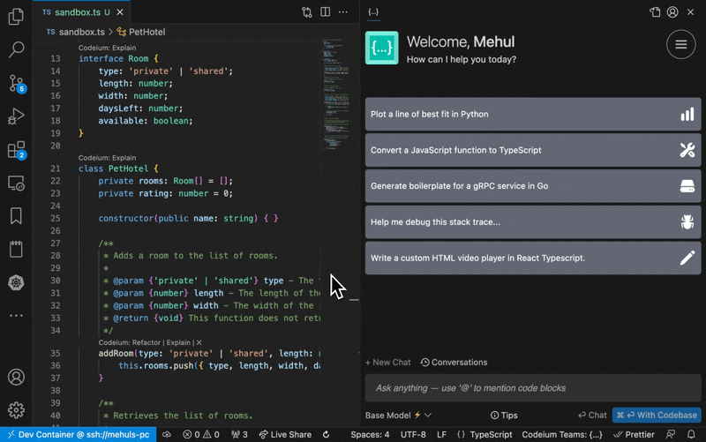
Chat – @mentions
To refer to context items within the chat input
Function names
Class names
Directories
Files
Terminal history
[…]
Notes:
In any chat message, you can use the @mentions feature to refer to context items from within the chat input by prefixing a word with @. Context items can be function names, class names, directories and files, or even content of your termnal history. By doing this explicitly, Codeium will make the most relevant suggestions for you.

Slide 8
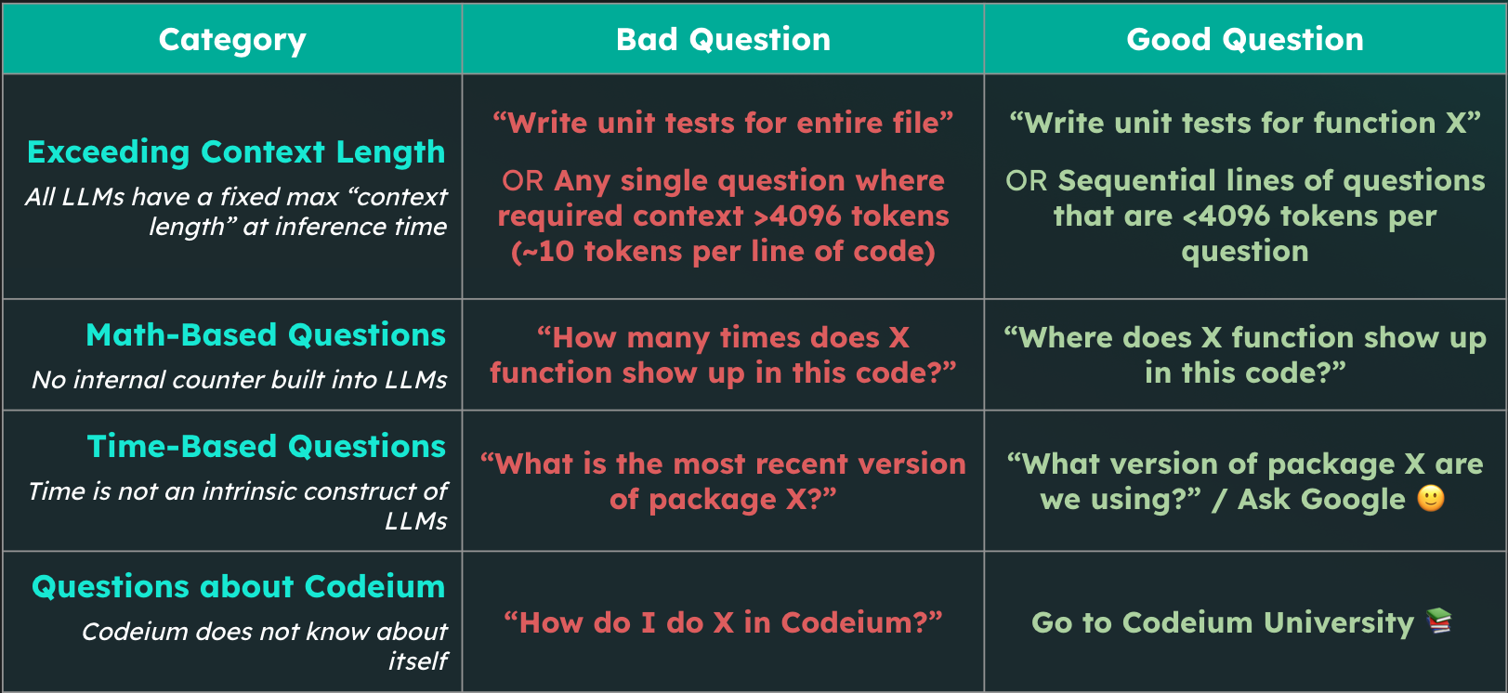
Chat – Prompting
Notes:
Clear and efficient prompting is a vital element of both Chat and Command features. There are three key components to a good prompt
Clear Objective: Be specific about what you want Chat to produce—whether it’s new code, a refactor, or an explanation.
Contextual Details: Use @ mentions to provide context, such as referring to specific functions, classes, or modules.
Constraints: If there are specific requirements, such as using certain frameworks or considering performance, include these in your prompt.
!! The prompting strategies we’re exploring here for Codeium aren’t just limited to this tool. These techniques (e.g., like being clear, concise, and specifying outputs) apply to many other AI-powered tools like ChatGPT, Copilot, and beyond. Mastering these skills will make your interactions with all AI tools more effective, no matter the platform!

Slide 9

Autocomplete
Boilerplate code
Repetitive functions
Code formatting and styling
Notes:
A key feature of Codeium is its Autocomplete function: with every keystroke, Codeium actively attempts to predict and complete what you’re typing. By analyzing the current file, previous edits, and contextual snippets from your codebase, it offers relevant suggestions as “ghost text”.
This feature can be particularly useful when you’re writing boilerplate code (which refers to repetitive code that often serves as a standard template), as it can save you time and reduce the likelihood of errors. By leveraging Codeium’s Autocomplete function, you can speed up your coding process and focus on the more creative and challenging aspects of your work.
By recognizing patterns in your codebase, Codeium can predict and suggest repetitive structures such as:
Boilerplate code: Generate routine code structures like class definitions, function signatures, or common initialization blocks with minimal effort.
Repetitive functions: Quickly replicate commonly used functions or methods that follow a similar pattern, reducing the need for retyping or copy-pasting.
Code formatting and styling: Maintain consistency in your code format by allowing Codeium to suggest and automate repetitive formatting tasks, saving you from manual corrections.

Slide 10
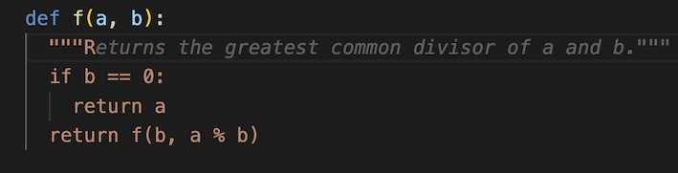
Autocomplete
Fill-in-the-middle (FIM)
Inline comments
Notes:
Codeium’s Autocomplete model also includes Fill-in-the-Middle (FIM) capabilities. This is crucial because, more often than not, you’re inserting code within an existing file, rather than just appending new lines. With FIM, Autocomplete analyzes the code both above and below the current line to provide more accurate suggestions.
You can guide the Autocomplete feature by using comments within your code. Codeium interprets these comments and generates code suggestions to implement what the comment describes.

Slide 11
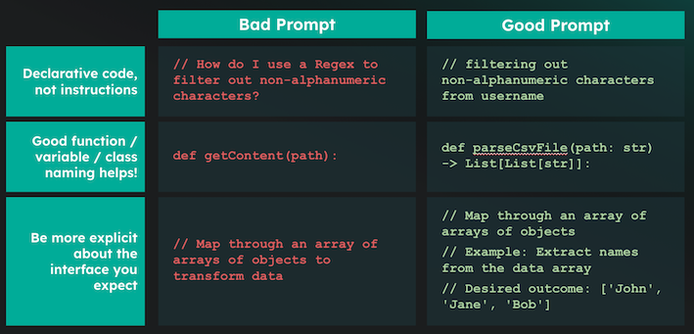
Autocomplete – Best practices
Notes:
Avoid manually triggering Autocomplete; instead, let it naturally enhance your workflow. Writing prompts as comments is not recommended, but decorating your code with quality comments and information variable/function names yields the best results.
To achieve the best results with Autocomplete, it’s important to enhance your code with clear, declarative (not instructive) code, descriptive function names, and good comments with examples of the desired inputs and outputs. See the table below for examples:

Slide 12

Hands-on

Slide 13
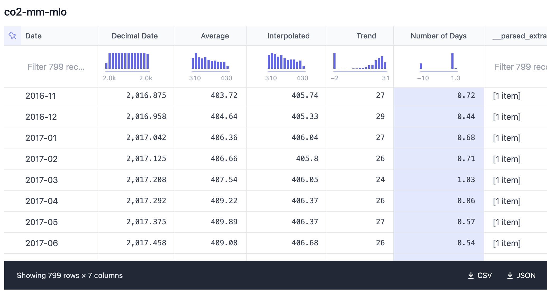
https://edu.nl/k6v7x
Notes:
Trends in Atmospheric Carbon Dioxide from 03/1958 to 09/2024, Mauna Loa, Hawaii, frequency of measurements once a month
Average: The monthly mean CO2 mole fraction determined from daily averages. If there are missing days concentrated either early or late in the month, the monthly mean is corrected to the middle of the month using the average seasonal cycle. Missing months are denoted by -99.99.
Interpolated: Values from the average column and interpolated values where data are missing.
Trend: Seasonally corrected. Trend values are linearly interpolated for missing months. -1 as nan value.
Number of Days: -9.99 denotes no data for number of daily averages in the month.

Slide 14

Break

